Slide 2
Learning objectives
In this lesson students will learn to:
  Explain the relationship between the width of the address bus and the number of memory locations that can be addressed
  Calculate the number of addressable memory locations provided by an address bus of a specified width.
For more details on this topic and additional student activities see Topic 3 of the student book.
© Pearson Education Ltd 2020. Copying permitted for purchasing institution only.
Notes:
Specification content: 3.1.1

Slide 3
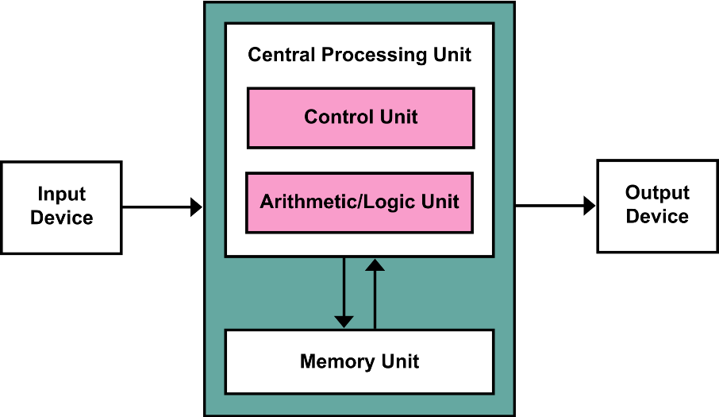
Recap
Instructions and data are stored in memory.
Instructions are fetched one at a time
into the processor.
The instructions are decoded by the
control unit.
The instructions are executed, sometimes
using the arithmetic logic unit.
The Central Processing Unit (CPU) contains the
Arithmetic/Logic Unit (ALU), Control Unit (CU) and registers.
Clock speed determines processor performance, i.e. the number of instructions per second.
Pipelining improves performance by overlapping parts of the fetch-decode-execute (F-D-E) cycle for multiple instructions.
© Pearson Education Ltd 2020. Copying permitted for purchasing institution only.

Slide 4
Instructions and data
In a computer everything is represented in binary.
This includes the instructions that the CPU needs to carry out.
Instructions and data are stored in RAM until they are needed by the CPU.
Each instruction and item of data is stored in a location in memory.
Each element of the memory has a unique address.
This means that each instruction has an address. The first memory element that contains the instruction is the address of that instruction.
© Pearson Education Ltd 2020. Copying permitted for purchasing institution only.

Slide 5
Buses
The CPU is connected to other components using a physical connection called a bus.
They are known as buses as they carry a number of bits of data simultaneously, in the same way that a bus carries many people at once.
There are three types of bus that connect to the components of the CPU and which connect the CPU to the rest of the computer’s components.
Data bus | Carries binary data from component to component – for example an instruction from RAM that is being transferred to the CPU.
Control bus | Carries signals that control the CPU components – for example a signal to start fetching the next instruction.
Address bus | Carries the address of a memory location – for example the address of an instruction being fetched from memory.
© Pearson Education Ltd 2020. Copying permitted for purchasing institution only.
Notes:
Buses are actually too small to see without magnification, but you can see how the buses are routed outside a microprocessor by looking at the gold pins of the microprocessor. Each of the pins represents a signal line or part of a bus that connects the microprocessor to the outside world. Looking at a mother board, you can see different kinds of buses (not necessarily data/address/control) represented by series of parallel lines of gold.

Slide 6
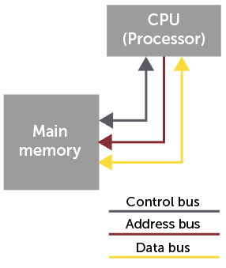
Buses
A bus is a set of parallel wires connecting two or more components of the computer
  When the CPU wishes to access a particular main memory location, it sends the address requested to memory on the address bus
  The data in that location is then returned to the CPU on the
  data bus
  Control signals are sent along the control bus

Slide 7
Directionality of buses
In the simple model of the computer discussed in these lessons, each of the three buses has directionality.
The control bus is bidirectional – it needs to carry status information to devices and to carry the status information signals that devices send back.
The data bus is bidirectional – two-way data transfer is required when reading and writing data to memory.
The address bus is unidirectional – the CPU can point to addresses in memory or to other devices, however those hardware components cannot point to an address in the CPU.
You will see this directionality represented in diagrams as single-ended or double-ended arrows.
© Pearson Education Ltd 2020. Copying permitted for purchasing institution only.
Notes:
Student Activity 1

Slide 8
Address bus
Do you know the difference between a 32-bit and a 64-bit CPU?
32-bit processors are cheaper, but can only use a limited amount of RAM.
The ‘bandwidth’ of these CPUs relates to the size of the address bus.
It refers to the number of unique memory addresses that can be accessed.
Let’s look at this in more detail, using the example of a simplified CPU with a low bandwidth.
© Pearson Education Ltd 2020. Copying permitted for purchasing institution only.

Slide 9
Address bus
Consider a CPU with a 4-bit bandwidth (address bus). How many unique memory addresses can it access?
4-bit addresses range from 0000 to 1111 inclusive.
1111 in denary is 15 (plus 1 because we must include 0), which gives 16 addresses.
16 addresses is 2^{4.}
Remember the formula to find the number of patterns in any number of bits: 2^{n}
This formula works for finding the maximum number of memory addresses as well.
© Pearson Education Ltd 2020. Copying permitted for purchasing institution only.
Notes:
Students should remember these patterns as they have already done the lessons on binary. They should also remember the formula for calculating the maximum number of patterns available in any number of bits. Remind them that they have already covered this.
Student Activity 2

Slide 10
Primary storage (memory)
A 32-bit CPU can access 4,294,967,296 unique memory locations.
Each memory location consists of a row of cells. Let's consider a situation where the row is 8 cells long.
Each of the 4,294,967,296 different addresses points to a row of 8 bits (1 byte).
That’s why a 32-bit CPU can only use 4GiB of RAM.
4 GiB addresses x 1 byte wide.
Address | Contents
0000 1011 | 0100 0100
0000 1010 | 0100 0011
0000 1001 | 0100 0010
0000 1000 | 0100 0001
© Pearson Education Ltd 2020. Copying permitted for purchasing institution only.
Notes:
Each time the address increases by a count of 1, the actual available storage goes up by the width of the memory cell (i.e. also the width of the address bus). So, address 00000011 is only 1 number up from 00000010, but it might represent a width of 8, 16, 32, or 64. Do not get confused between maximum memory addresses and maximum size of memory in bits.
The content of the memory in the table, from bottom to top, is ‘A’, ‘B’, ‘C’, ‘D’.

Slide 11
Memory (RAM)
Random Access Memory (RAM) is volatile memory – this means that its contents are erased when its power supply is turned off.
RAM is often referred to as ‘primary storage’, as it sits close to the CPU.
However, it isn’t possible to keep a computer on permanently. So it is necessary to have somewhere to store the programs and data (that make a computer general purpose) when the power is switched off.
The non-volatile storage required for this job is most often a hard disk.
Hard disks are often referred to as ‘secondary storage’, to make them distinct from ‘primary storage’.
© Pearson Education Ltd 2020. Copying permitted for purchasing institution only.
Notes:
Students may confuse the term ‘storage’ with secondary storage, i.e. hard disks. One way to help them get the concept right is to refer to memory (RAM) as primary storage, to hard disks as secondary storage, and to other types of storage (DVDs, USB sticks, etc.) as tertiary storage. The terms ‘primary’ and ‘secondary’ are important, as they demonstrate the distinction between RAM and hard disks.
Student Activity 3

Slide 12
Wrap up: you have learned how to…
Explain the relationship between the width of the address bus and the number of memory locations that can be addressed.
  Each unique address identifies 1 row of memory cells.
  The more ‘bandwidth’ that is available in the address bus, the higher the number of individual addresses that can be accessed.
Calculate the number of addressable memory locations provided by an address bus of a specified width.
  Use 2^{n} to calculate the number of addresses that can be accessed by the CPU.
© Pearson Education Ltd 2020. Copying permitted for purchasing institution only.

